Slide 1
Business Intelligence Intelligent Business
Cameron Cox, III, MHA, FACMPE
CEO, MSOC Health

Slide 2
Learning Objectives
Definitions: (Big) Data, Dashboard, Analytics
Review effective dashboard principles
Understand important differences between data, analysis and presentation
Recognize differences in analytics
Review Financial Metrics, Analytics in a practice setting
Notes:
Honestly. If I accomplish one thing in this presentation, I would hope that you as leaders in healthcare insist on simple, meaningful, timely reports/dashboards

Slide 3
Agenda
What is (big) data? What is a dashboard? What is analytics?
Design Principles of a dashboard
Data and Analysis
Design
Presentation
Principles of Analytics
Real Time
Predictive
Historical
Business Intelligence – How to use it…
Notes:
Enough about me. Here’s what we’re going to talk about for the next 35 minutes.

Slide 4
What is (big) data?

Slide 5
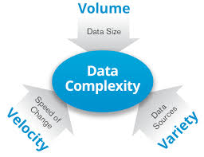
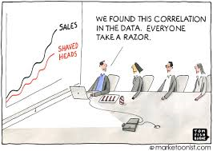
Latest Buzzword

Slide 6
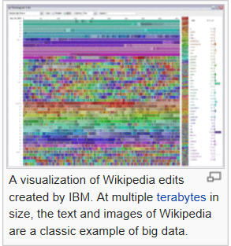
Who better to explain than the internet?

Slide 7
Big Data at work…

Slide 8
What is a dashboard?
Notes:
Dashboards have been around for years. Have fallen far short of their potential
Despite Tech improvements, dashboards haven’t kept up.
We all know what a dashboard is right?

Slide 9
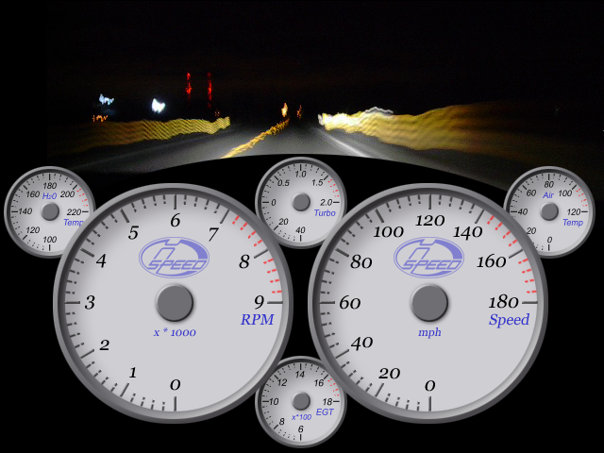
It’s hard to drive without a dashboard
Keep your eyes on the road but…..
Notes:
Here it is.
Although the automobile analogy is a bit overdone, everybody understands this.

Slide 10
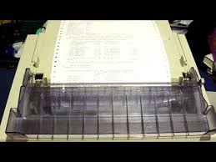
What is not a dashboard?
Report
Just because it’s on-line or web based
Just because it’s real time
Balanced Scorecard
Tool to dive into detail
Just because it has gauges and graphs
Notes:
There are a lot of reports that call themselves Dashboards. I asked our leaders to send to me any dashboards that they had seen. Honestly, I got a lot of reports with 30 to 50 columns and the same number of rows.
Thermometer is real time but it’s not a dashboard.

Slide 11
A dashboard is …
… a visual display of the most important information needed to achieve one or more objectives, consolidated and arranged on a single screen so the information can be monitored at a glance.
Notes:
Best definition of a dashboard I’ve seen.
A dashboard should tell a story and tell it quickly
A dashboard is the starting point to finding the answers, not the ending point

Slide 12
Dashboards
The Chosen Tool for Consolidating Data Simply

Slide 13
Please count the # of 7’s in this array:
59374304814959730493
70241382710993183453
59474942479103587494

Slide 14
Now count the # of 7’s:
59374304814959730493
70241382710993183453
59474942479103587494
Notes:
Now count the sevens. If you want people to count something, don’t hide it.

Slide 15
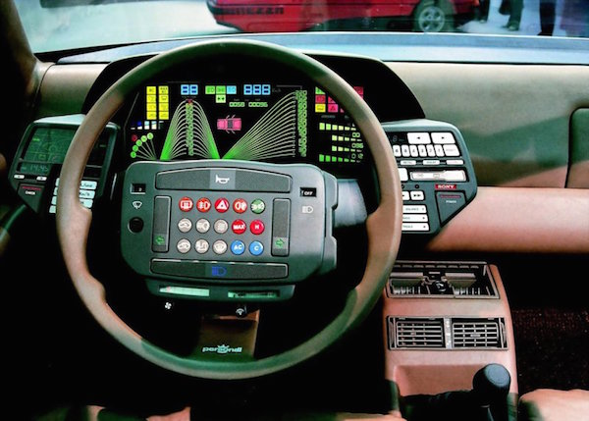
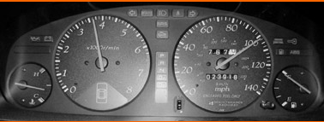
This….not that

Slide 16
A Dashboard’s Hierarchy of Needs
Clear Presentation
Formulated Analysis
Large Data Set
Notes:
This represents the approach you should take in creating a dashboard. Several sources recommended you focus on the data first and then worry about the presentation.
I disagree, like Stephen Covey and my good friend Dr. David Thompson I believe you should begin with the end in mind…..the presentation. Then build the data and then the analysis.
Another concept is to maximize the amount of data per pixel presented. Data to pixel ratio.

Slide 17
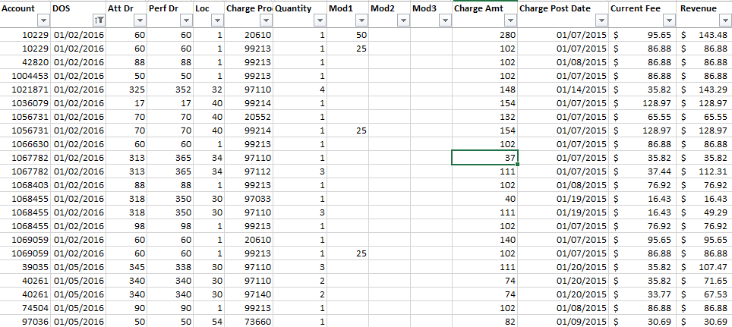
Data
Notes:
Let’s go through a quick example of Data, Analysis, Presentation for a dashboard component. Let’s say you want to understand the impact of a potential change in your contracted rates with an insurance carrier.
Take this simple listing of raw data.

Slide 18
Analysis
Notes:
You then can analyze by creating formulas that group CPTs into categories and compare current to proposed rates and revenue.

Slide 19
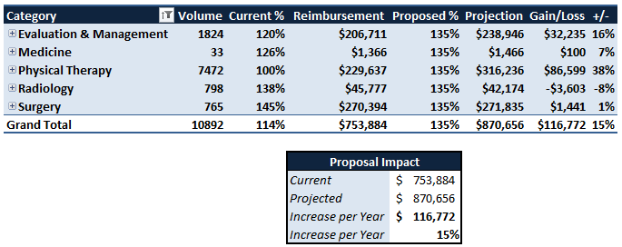
Presentation
Notes:
Lastly, here’s the presentation that goes on your dashboard. A histogram with cummulative % on right vertical access.

Slide 20
What is the purpose of dashboard?
Mission Statement
Audience
Performance Measures (KPI & Metrics)
What logical groupings will organize the info best?
What comparisons should be made?
How frequently will it be updated?
What actions might be taken?
Notes:
Visual presentation of performance measures
Saves time compared to running multiple reports
Gain total visibility of multiple systems instantly
Quick identification of data outliers and correlations

Slide 21
WATCH OUT! Potential gap ahead…

Slide 22
Time…understand it in your analysis. Real Time versus Time Trends
Airline Pilot or ICU physician or Call Center
Retail, Financial, Manufacturing
Closer to real time better
Understanding secular/historical trends important also
Notes:
Depends on the purpose of the dashboard. Doesn’t do much good to tell a pilot after the plane has crashed that his airspeed was below minimum.

Slide 23
Trends
Hour by Hour, Day by Day, Week by Week
Month by Month, Quarter by Quarter
Compare to prior hour, day, week, month, quarter, year
Month to Date, Quarter to Date, Year to Date
Notes:
How you measure trends

Slide 24
Context/Comparisons add Perspective
Historical
Last period
Last period 1 year ago
Benchmark
Goals or Budgets
Relative to other providers
Forecast
Notes:
A stand alone number really doesn’t always communicate.

Slide 25
You Need Good, Unfiltered Data
Available-Who did you have to toss under the bus to find this information?
Reliable -Do you believe these #’s?
Relevant
Timely-Last years data is too late.
Simple, simple, SIMPLE
Notes:
Regarding Data, I don’t care if you’re using a data warehouse, data townhouse, data outhouse or data doghouse. When you’re starting, keep it simple.

Slide 26
What is analytics?
Notes:
Dashboards have been around for years. Have fallen far short of their potential
Despite Tech improvements, dashboards haven’t kept up.
We all know what a dashboard is right?

Slide 27
Structured Breakdown with purpose
Detailed examination of the elements
Identifying the elements
Separating the elements into constituent elements
Measuring the elements

Slide 28
Analytic Continuum
Descriptive-
What happened?
Diagnostic-
Why did it happen?
Predictive-What will happen?
VALUE
DIFFICULTY
Notes:
What kind of analytics should be on the dashboard.
Here’s what Gartner Analytics Continuum says
Another way to think about this….Economists sometimes call these lagging indicators, concurrent indicators and leading indicators

Slide 29
Real Time Analytics

Slide 30
How does this work?

Slide 31
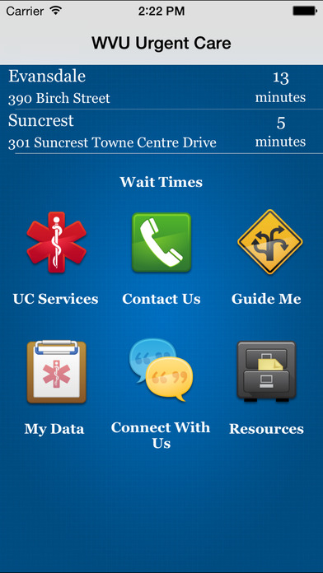
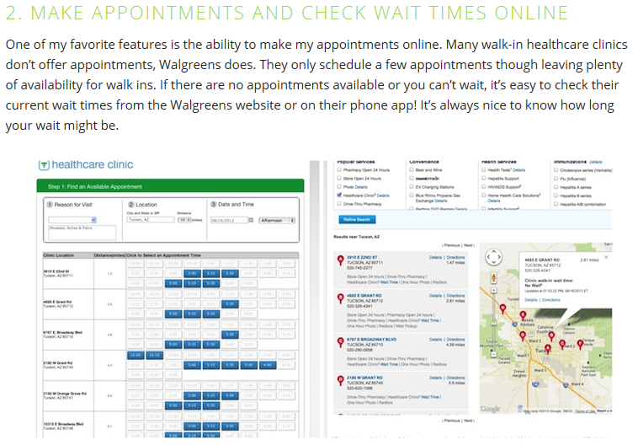
Okay…how does this work in healthcare?

Slide 32
Predictive Analytics

Slide 33
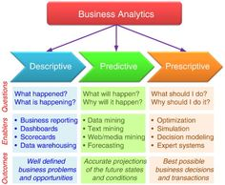
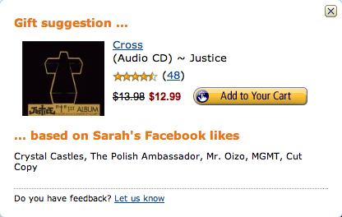
How does it work?

Slide 34
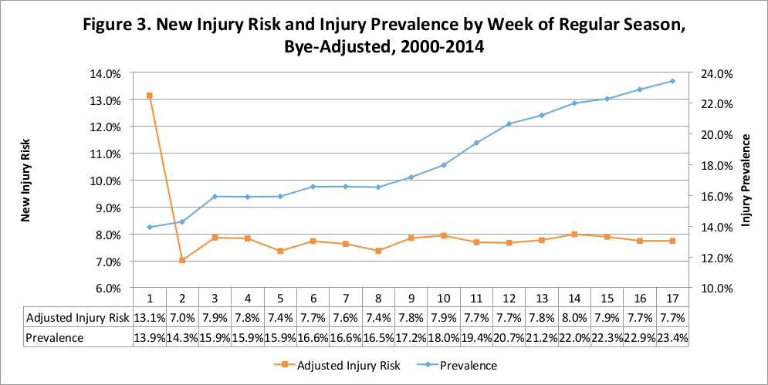
How does it work in healthcare?
Increase Marketing Dollars during end of season
Have more open scheduling slots during end of season

Slide 35
Another example
Double book one week follow-ups with other appointments to keep utilization high
Group one week follow-up slot times; advertise walk in availability at same times
Change booking pattern; encourage patients to self-schedule follow ups
Notes:
Most no shows are appointments scheduled exactly 1, 2, 3, 4 weeks out from the day they are booked (which are most likely follow-up appointments booked at check out)
Predictive analytics demonstrates the pattern and allows you to plan ahead for potential no shows

Slide 36
Data – What do we want to measure…analyze…present
Notes:
Now lets look at Hospitalist and ED specific items.

Slide 37
Types of Data
Volume
Productivity (patients, encounters, days worked)
Activities (procedures, labs, x-ray, calls)
Hours/Shifts
Quality & Clinical
Clinical Quality
Patient Satisfaction
Billing & Financial
Charge Capture & Gross Revenue
Costs
Collections
Profit/Loss
Notes:
3 General Areas of Area.

Slide 38
I. Volumes
Patient Encounters per day/provider/group
Procedures per E&M
Year to Year trends/ Seasonality
Admits/Discharges
By Financial Class
Day of Week
By CPT Code
By ICD-9 (soon -10)
Notes:
Patient volume is critical in any medical group. It determines the staffing. Type of volume determines the type of providers needed.

Slide 39
II. Quality & Clinical
X-rays per ICD-10
Scripts per encounter
Volume of Preventative Well Visits
Vaccinations to total practice population
Core Measures
Nurse calls
Lab Response Times
Patient Education Delivery
Recall rates
Patient satisfaction
Wait Times
Notes:
Glad to see we are doing more quality and clinical items.

Slide 40
III. Billing & Financial
RVU per encounter
Cost per procedure/category
Code Distributions
Patient Responsibility per encounter
Patients by Payer Class
Accounts Receivable > 90 days
PQRS Capture
Insurance Denials
Notes:
Then of course you have the billing and financial itms.

Slide 41
Don’t Let Tools Confuse You
The Best Tool is Your Brain

Slide 42
Always Remember:
A Dashboard is a Presentation of the Data
Analytics is an interpretation of the Data
Basics to not forget!!!
P&L
A/R Analysis
Revenue Flow
Financial Classification

Slide 43
Thank you for your time!
Contact
Cameron M. Cox, III
Cameron.Cox@msochealth.com
919-960-0336

Slide 44
Connect with us
www.facebook.com/MSOCHealth
www.linkedin.com/company/MSOC-Health
http://www.msochealth.com/blog/

Slide 45
Thank You
Thank You
MSOC Health
(866) 347-0001
200 Timber Hill Place Suite 221 Chapel Hill, NC 27514
www.msochealth.com

